Slide 1
ITCS 6144/8144 Course Project
Understand Linux OS via Dynamic Tracing Tool (Systemtap)
(Final Presentation)
Abdullah Al Raqibul Islam (UNCC ID # 801151189)

Slide 2
Motivation
Finding software bugs due to incorrect system setup
System administrator perform instrumentation in finding those bugs
it could be performance statistics collection and their analysis
debug or system audit
One of the common approaches to instrumentation is “sampling” by installing probes at specified places of software
collect state of the system: values of some variables, stacks of threads, etc.
Sampling is very helpful when you do not know where issue happens
for example, some function, say foo() that processes lists of elements, consumes 80% of the time, but doesn't say why
list is too long
list is inappropriate data structure for foo()
With tracing we can install a probe to that function, gather information on lists (say their length) and collect cumulative execution of function foo(), and then cross-reference them, searching for a pattern in lists whose processing costs too much CPU time.

Slide 3
Platform
Centos 7 on VirtualBox
Kernel: Linux 3.10.0-957.el7.x86-64
Systemtap translator/driver: 3.3/0.172

Slide 4
Project Overview
Understand and observe the internal behaviors and performance characteristics of Linux operating system
Prepared several systemtap script to understand
System-call
Process
Virtual File System
Virtual Memory

Slide 5
Work Done
To Understand System Calls (till midterm)
Within specific time duration, observe all the system calls issued
by a process, and, in the whole system
Within specific time duration, trace time spent in all system calls in a per process way
To Understand Processes (till midterm)
Trace parent-child tree of a process
Detailed current process information
Trace the time duration a process takes before the process actually starts to execute.
To Understand Virtual File System
Trace page faults
To Understand Virtual Memory System
Trace file open/close/read/write/mmap operations done in the system
Trace the above mentioned ops in a per-process way (to be added in the final report)

Slide 6
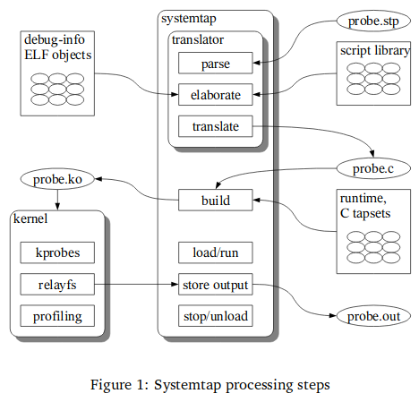
Systemtap Processing Steps

Slide 7
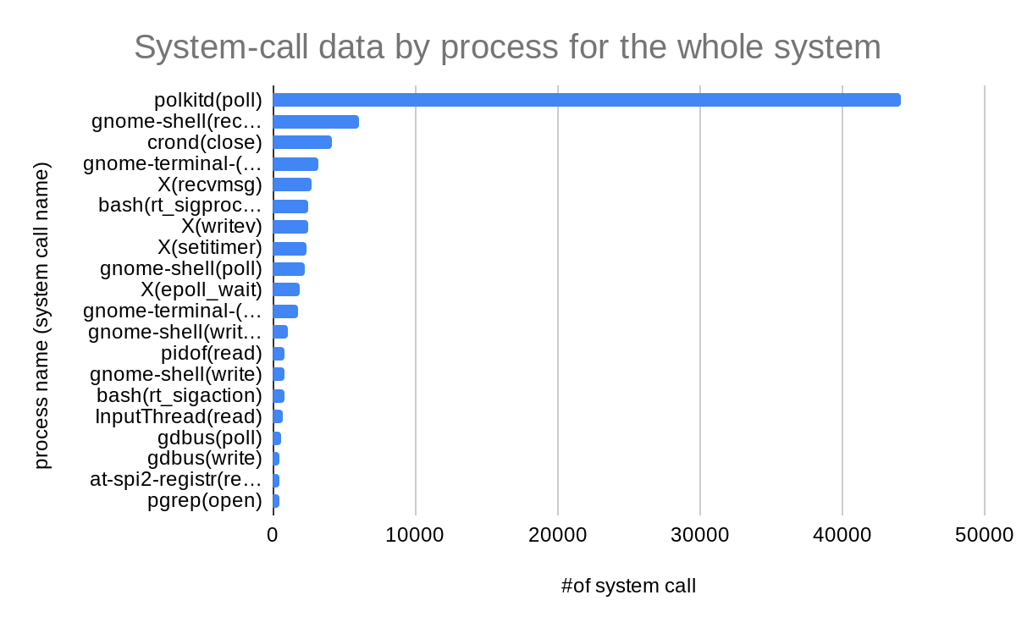
Operating system kernel tracing (Understand System Calls)
Systemtap script output: Count of system-call (in the whole system)

Slide 8
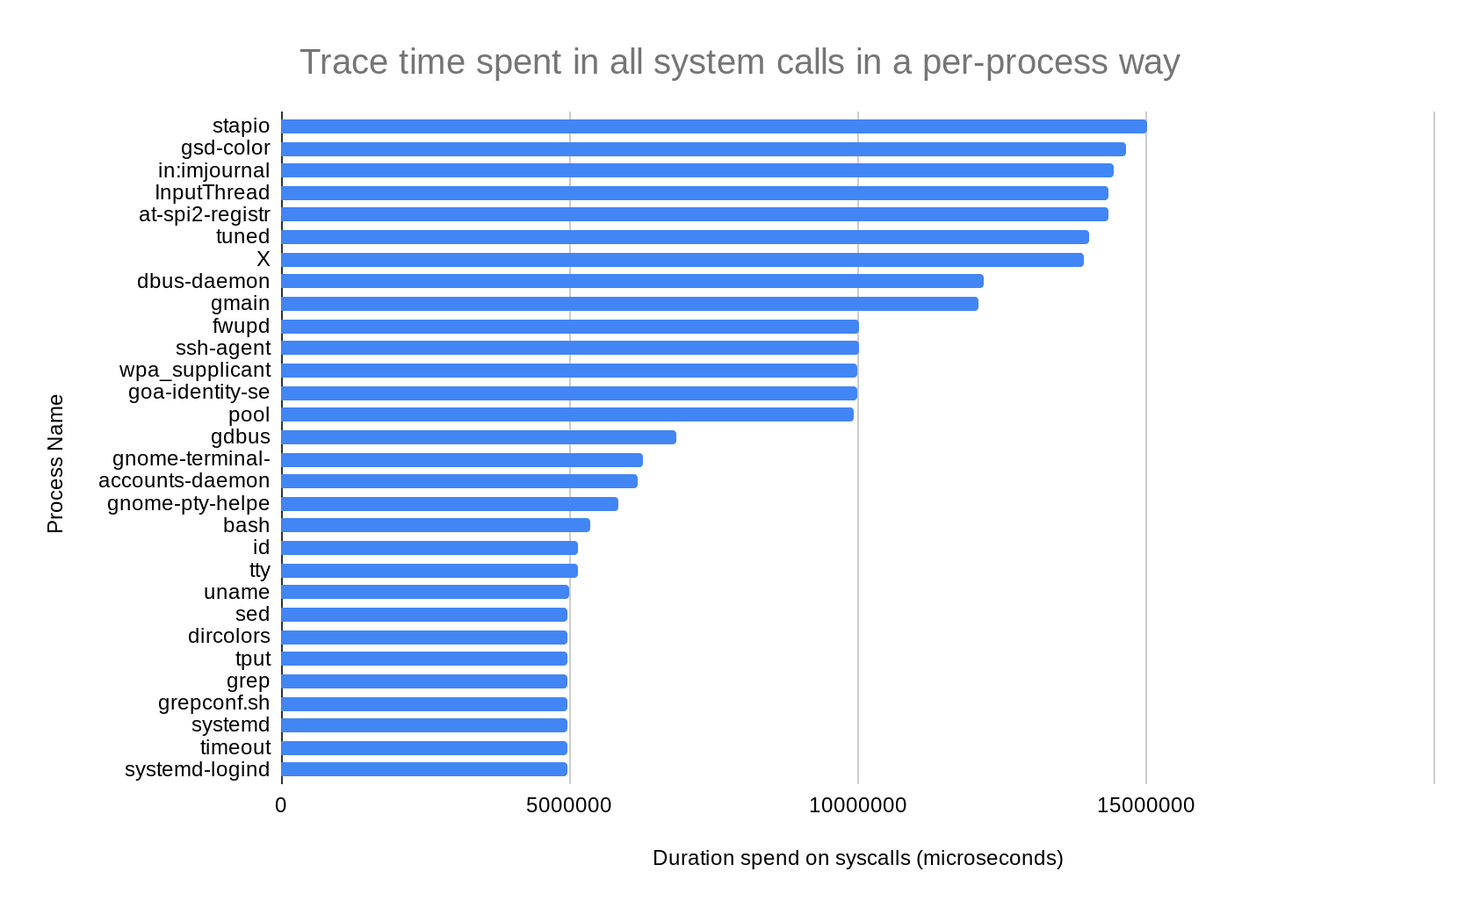
Operating system kernel tracing (Understand System Calls)
Systemtap script output: Trace time spent (per process in the whole system)

Slide 9
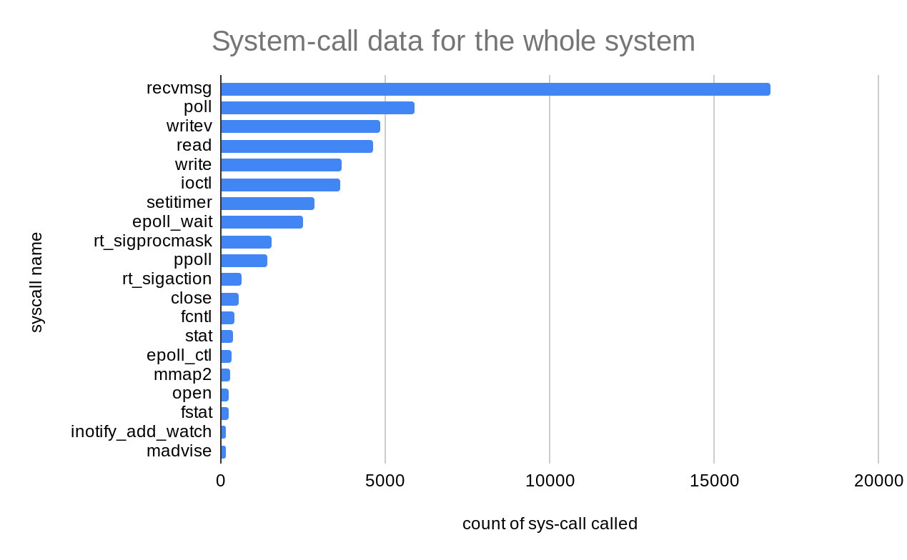
Operating system kernel tracing (Understand System Calls)
Systemtap script output: system-call data for the whole system

Slide 10
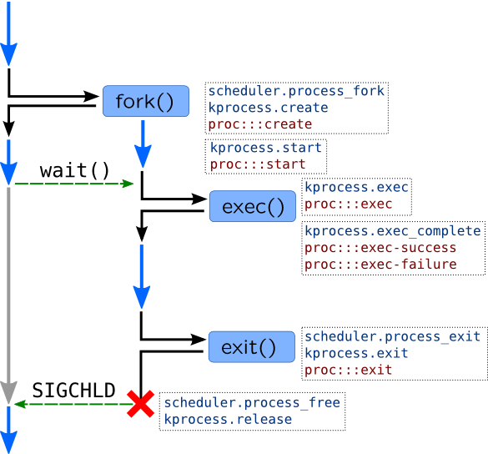
Operating system kernel tracing (Understand Process)
Lifetime of a process and corresponding probes are shown here ->
Unix process is started by a two stage way,
Parent process calls fork() system call
Kernel creates exact copy of a parent process including address space
If fork() is successful, it will return in the context of two processes (parent and child).
Child process calls execve() system call
to replace address space of a process with a new one based on binary which is passed to execve() call
In completion of a process,
When child process finishes its job, it will call exit() system call.
If parent wants to wait until child process finishes, it will call wait() system call, which will stop parent from executing until child exits.

Slide 11
Operating system kernel tracing (Understand Process)
Processes may be traced with kprocess and scheduler tapsets in SystemTap. Here are some useful probes:
Action | SystemTap Probes
Process creation | kprocess.create scheduler.process_fork
Forked process begins its execution | kprocess.start: called in a new process context Scheduler.wakeup_new: process has been dispatched onto CPU first time
execve() | Kprocess.exec: entering execve() Kprocess.exec_complete: execve() has been completed, success variable has true-value if completed successfully, errno variable has error number in case of error
Process finished | kprocess.exit scheduler.process_exit
Process structures deallocated due to wait()/SIGCHLD | kprocess.release scheduler.process_free

Slide 12
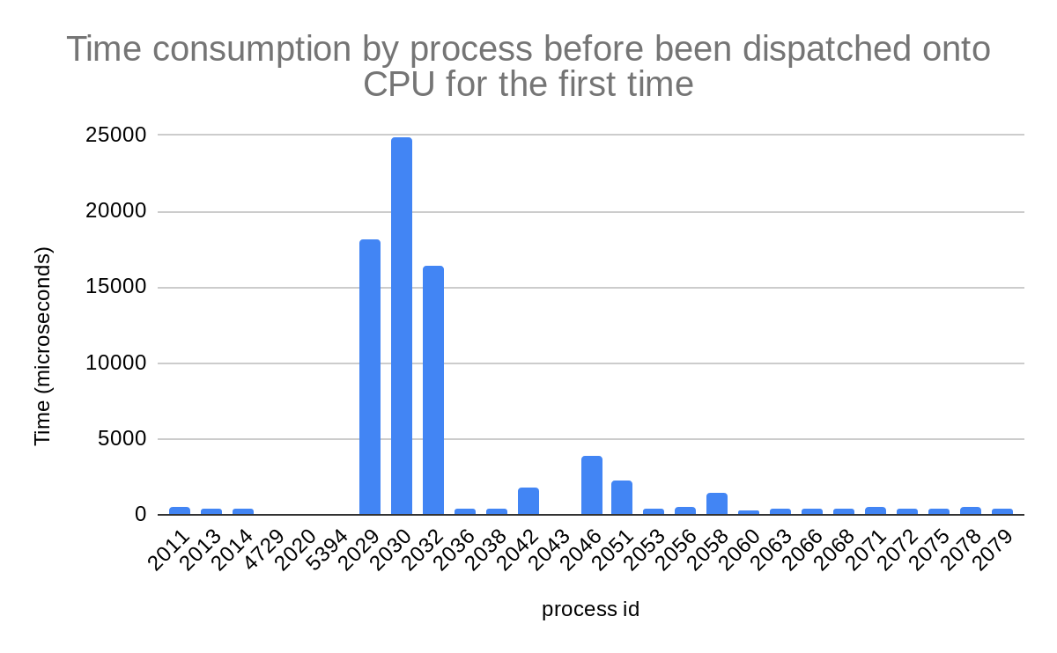
Operating system kernel tracing (Understand Process)

Slide 13
Understand Virtual File System
Trace file open/close/read/write/mmap operations done in the system
Demonstrate output by using Systemtap’s @hist_log
@hist_log(v) represents a base-2 logarithmic histogram
intervals for read -- min:0us avg:3us max:86us count:888 8 value|----------------------------------------------------------------------------------------------------------------------------------------- count 0 | 7 1 |@@@@@@@@@ 97 2 |@@@@@@@@@@@@@@@@@@@@@@@@@@@@@@@@@@@@@@@@@@@@@ 456 4 |@@@@@@@@@@@@@@@@@@@@@@@@@ 258 8 |@@@@@@ 66 16 | 2 32 | 1 64 | 1 128 | 0 256 | 0

Slide 14
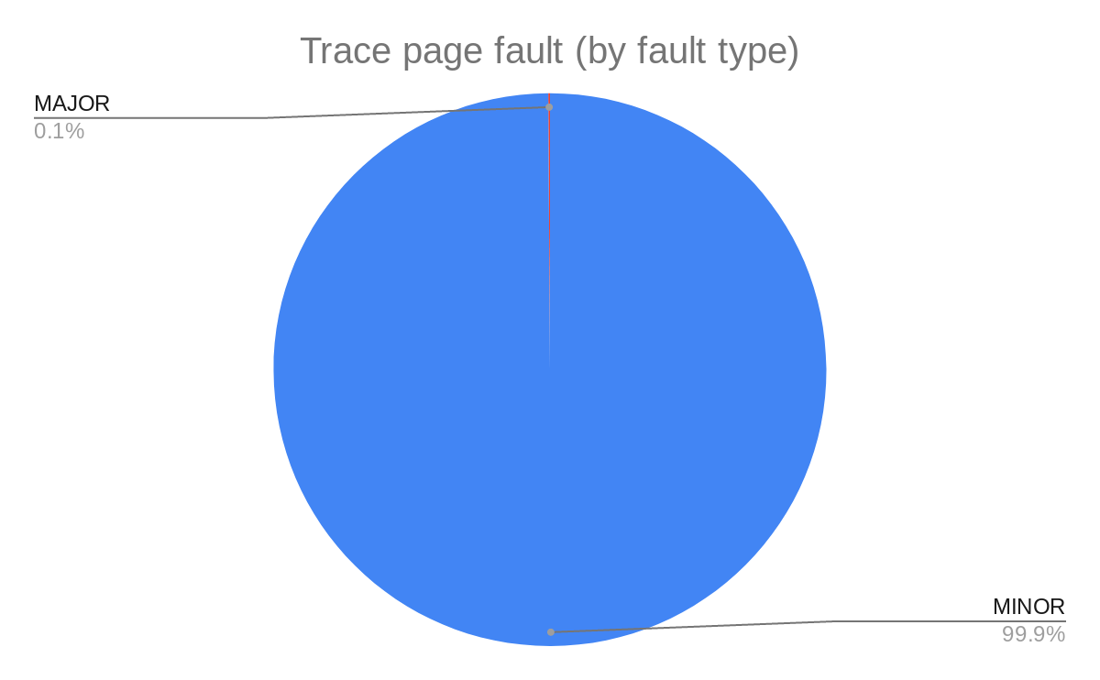
Understand Virtual Memory System
Page fault: when program accesses memory, memory management unit (MMU) do the following process:
takes address -> finds an entry in a page table -> gets physical address
That entry, however, may not exist in the page table. In that case CPU will raise an exception called a page fault. There are three types of page faults that may happen:
Minor page fault: occurs when page table entry should exist, but corresponding page wasn't allocated or page table entry wasn't created. For example, Linux do not allocate mmapped pages immediately, but wait until first page access which causes minor page faults.
Major page fault: occurs when it is required to read from disk. It may be caused by accessing memory-mapped file or when process memory was paged-out onto disk swap.
Invalid page fault: occur when application access memory at invalid address or when segment permissions forbid such access. For example writing into text segment, which is usually disallowed. In this case OS may raise SIGSEGV signal.
A special case of invalid page faults is copy-on-write fault which happens when forked process tries to write to a parent's memory. In this case, OS copies page and sets up a new mapping for forked process.

Slide 15
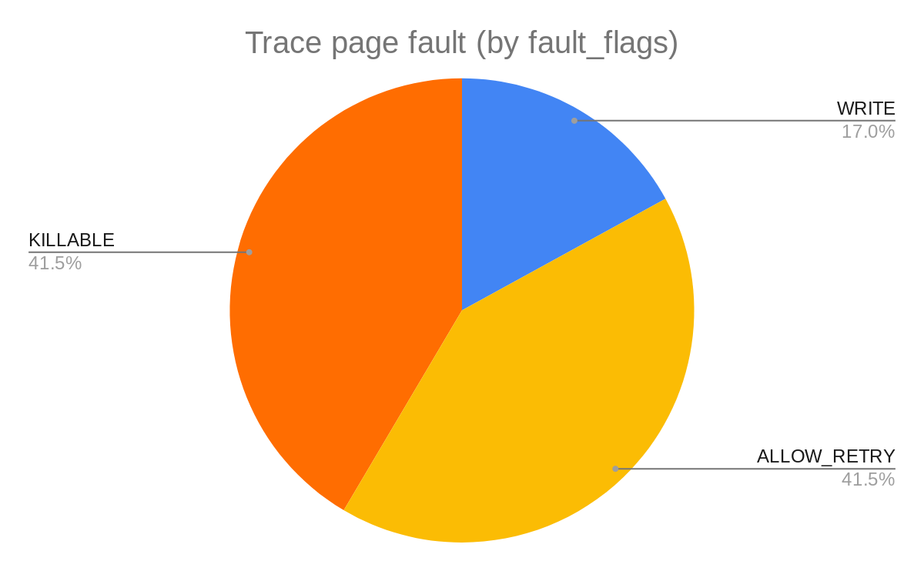
Understand Virtual Memory System
FAULT_FLAG types with reason to raise it:
WRITE: Fault was a write access
MKWRITE: Fault was mkwrite of existing pte
ALLOW_RETRY: Retry fault if blocking
RETRY_NOWAIT: Don't drop mmap_sem and wait when retrying
KILLABLE: The fault task is in SIGKILL killable region
TRIED: Second try
USER: The fault originated in userspace
REMOTE: faulting for non current tsk/mm
INSTRUCTION: The fault was during an instruction fetch

Slide 16
Reference
Dynamic Tracing with DTrace & SystemTap: https://myaut.github.io/dtrace-stap-book/
Architecture of systemtap:a Linux trace/probe tool: https://sourceware.org/systemtap/archpaper.pdf
SystemTap Beginners Guide: https://lrita.github.io/images/posts/systemtap/SystemTap_Beginners_Guide.pdf
SystemTap Tapset Reference Manual: https://sourceware.org/systemtap/tapsets/

Slide 17
Thank you

